Slide 1
Music Genre Classification
Cse-465 section-01

Slide 2
At first:
Setup environment, download dataset, load the libraries.
Dataset Link:
`http://marsyas.info/downloads/datasets.html
Total Classifiers : 10

Slide 3

Visualizing the Data:
Waveform
Spectrogram
Playing Audio
Fig: Jupyter Widget for playing audio

Slide 4
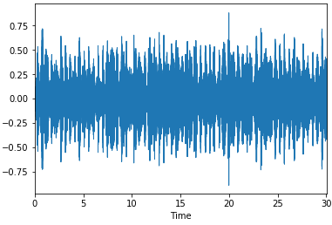
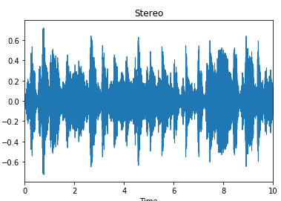
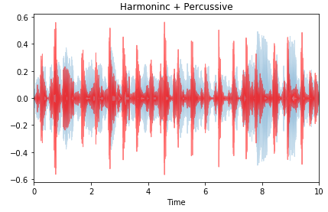
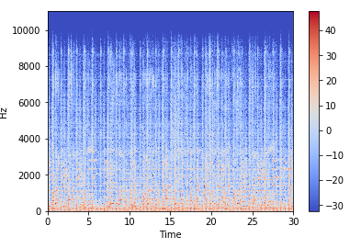
Figure1: Monophonic wave
Figure2: Stereo wave
Figure3: Harmonic & Percussive wave
Figure4: Spectrogram

Slide 5
Preprocessing:
Feature Extraction
Zero Crossing Rate
Spectral Centroid
Spectral Rolloff
Mel-Frequency Cepstral Coefficients
Chroma Frequencies

Slide 6
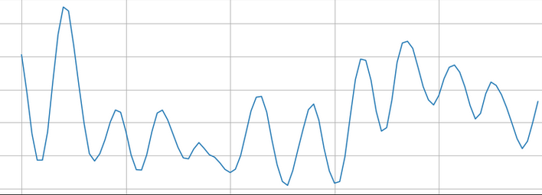
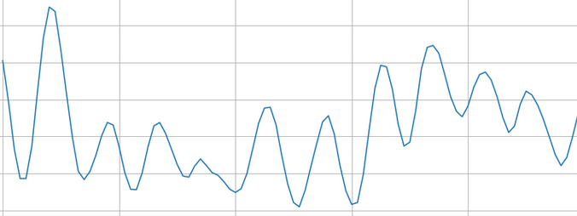
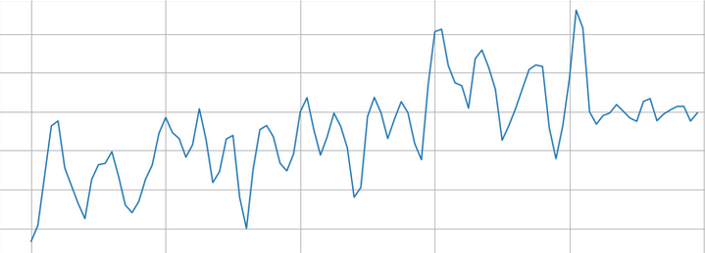
Zero Crossing Rate:
Fig: ZCR blues
Fig: ZCR Country
Fig: ZCR Metal

Slide 7
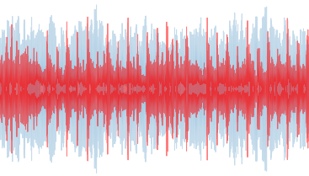
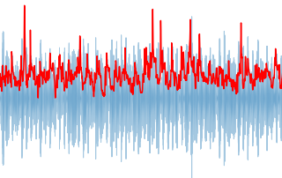
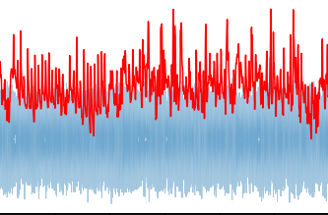
Spectral Centroids:
Fig: SC for Blues
Fig: SC for Metal
Fig: SC for Metal

Slide 8
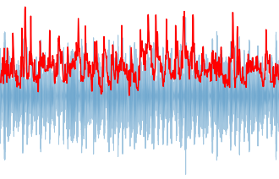
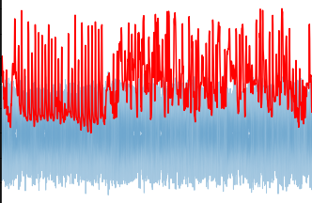
Spectral Rolloff
Fig: SR for Blues
Fig: SR for Metal

Slide 9
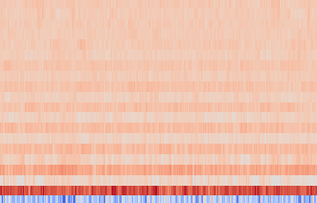
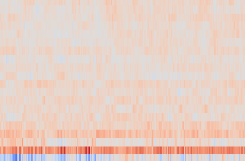
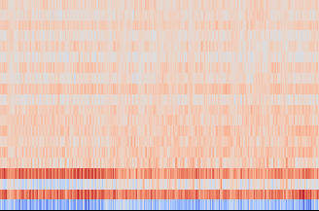
Mel-frequencies coefficiets
Fig: MFCC for Blues
Fig: MFCC for Country
Fig: MFCC for Metal

Slide 10
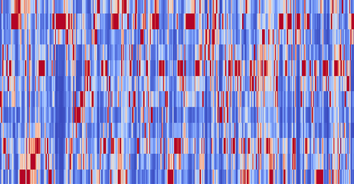
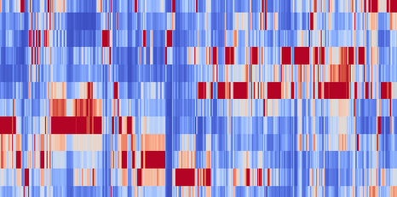
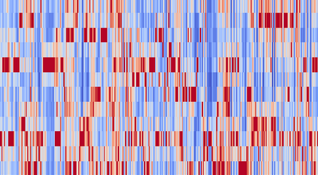
Chroma Frequencies
Fig: CF for Blues
Fig: CF for Country
Fig: CF for Metal

Slide 11
Thank You

